Slide 1

save and restore - without meta graph

Slide 2
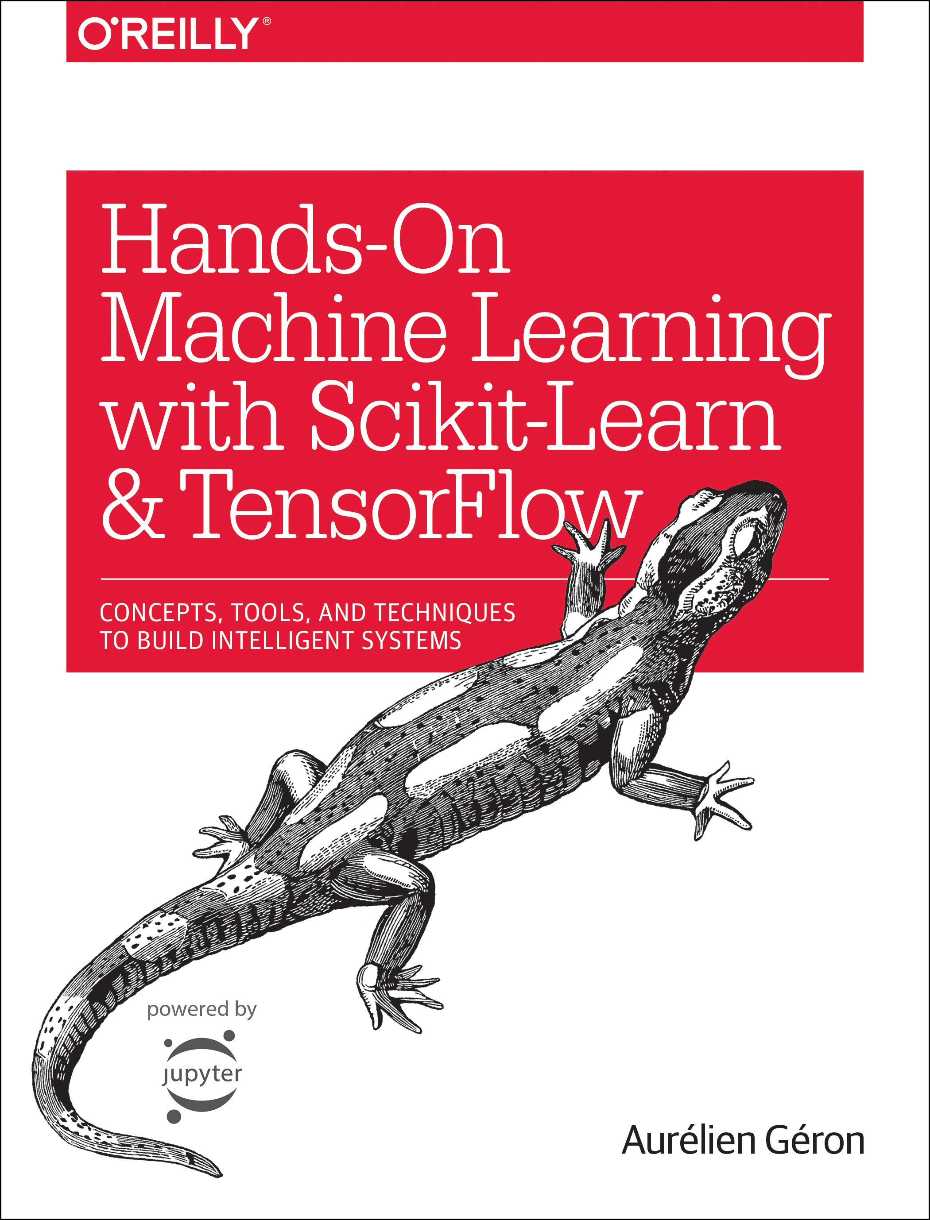
Reference
Chapter 11 (O'Reilly) of Hands-On ML
Youtube
Code

Slide 3
Data

Slide 4
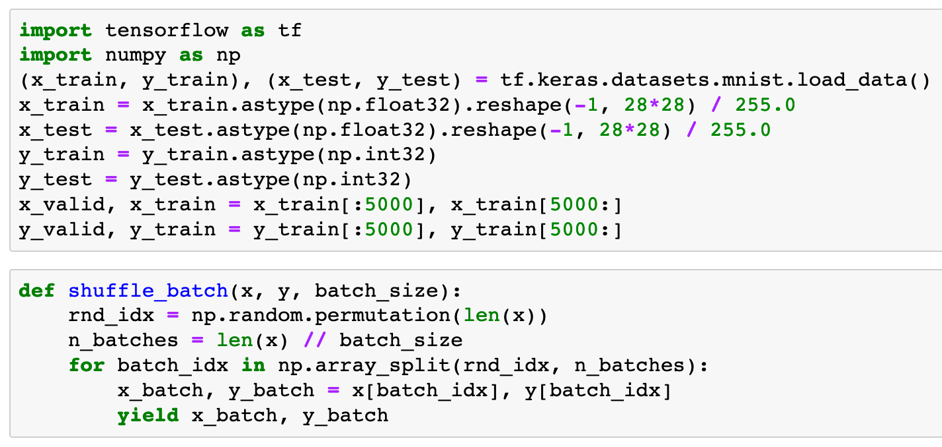


Slide 6
Warm Up

Slide 7
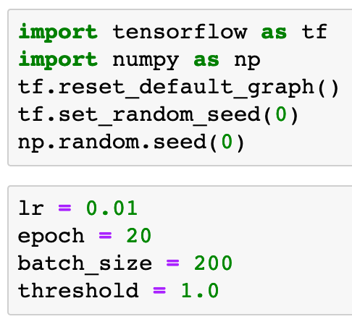

Slide 9
Graph

Slide 10
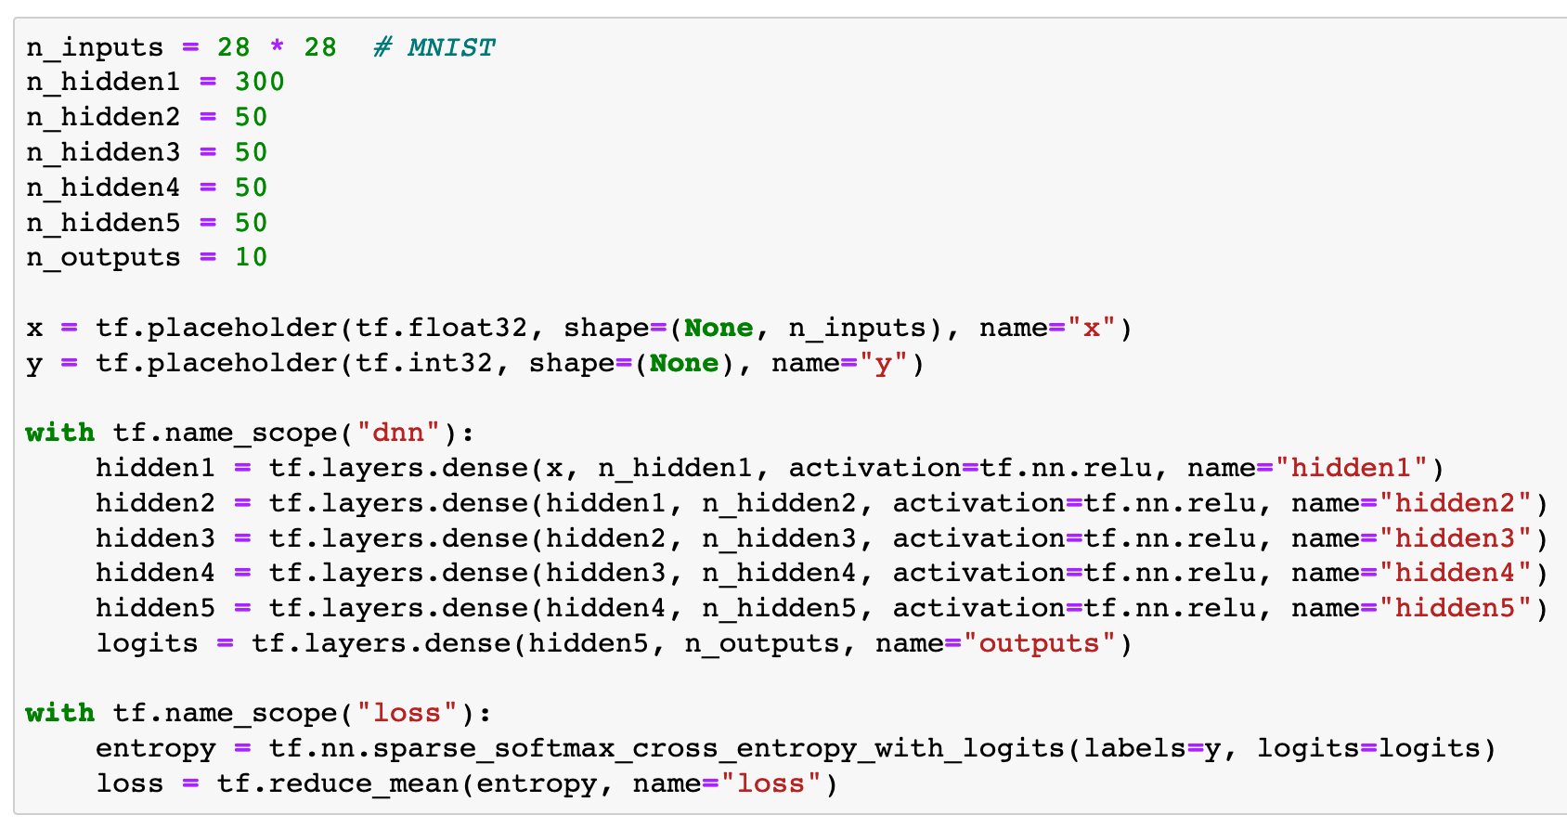

Slide 11
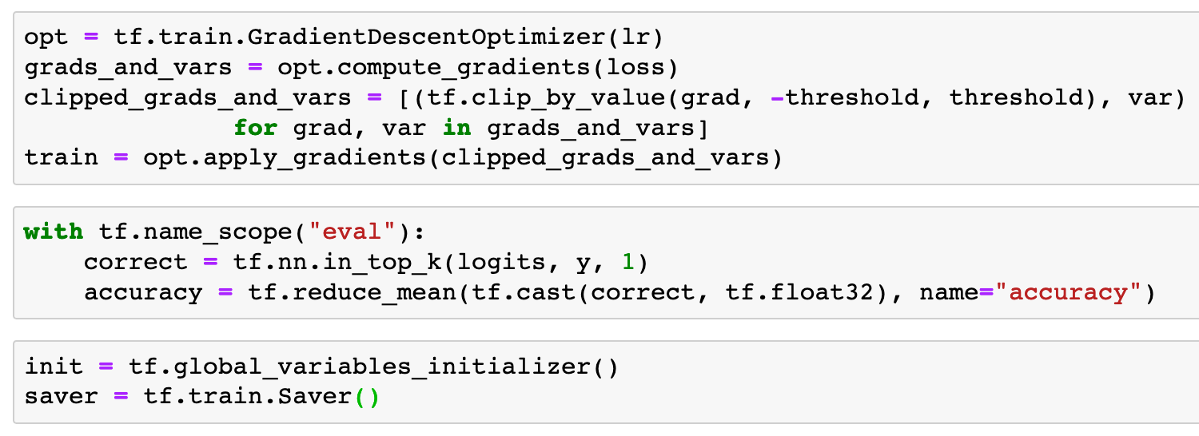

Slide 14
Session

Slide 15
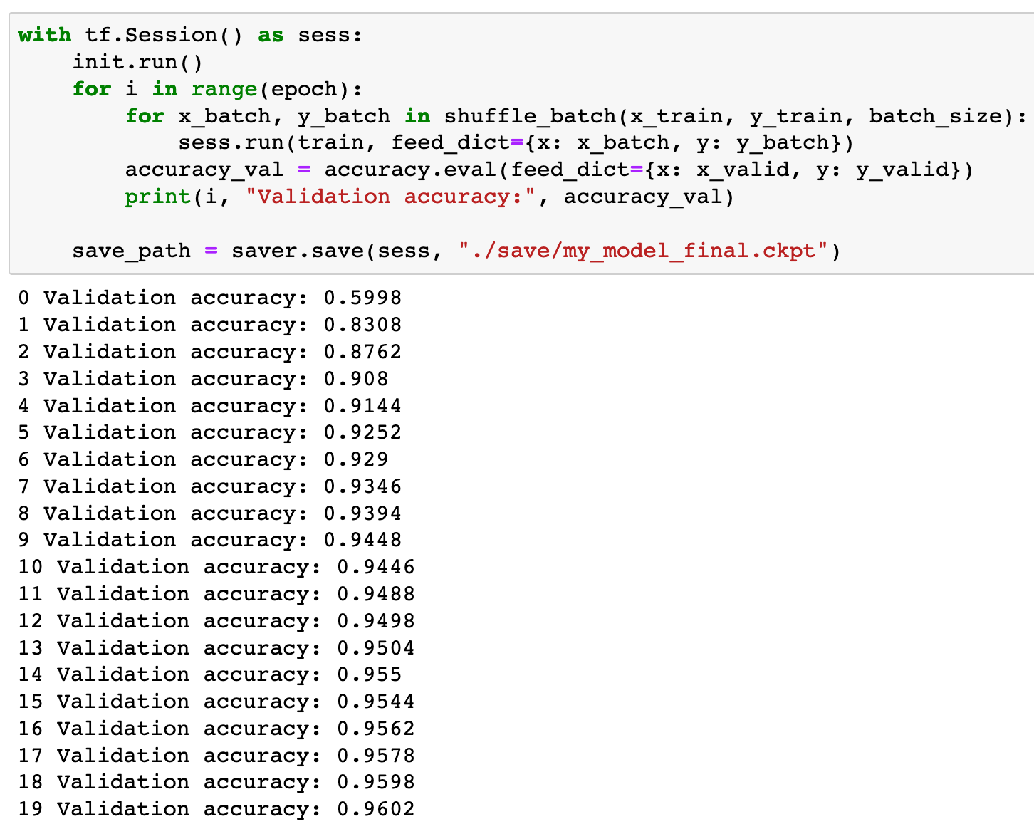

Slide 16
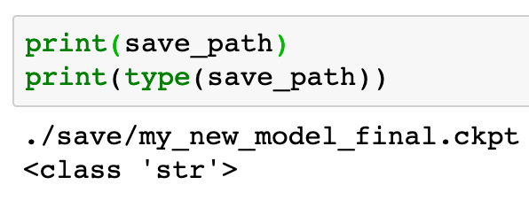

Slide 17
Restore

Slide 18
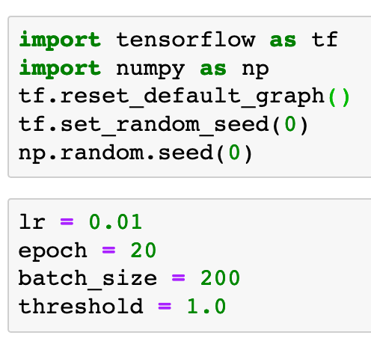

Slide 19
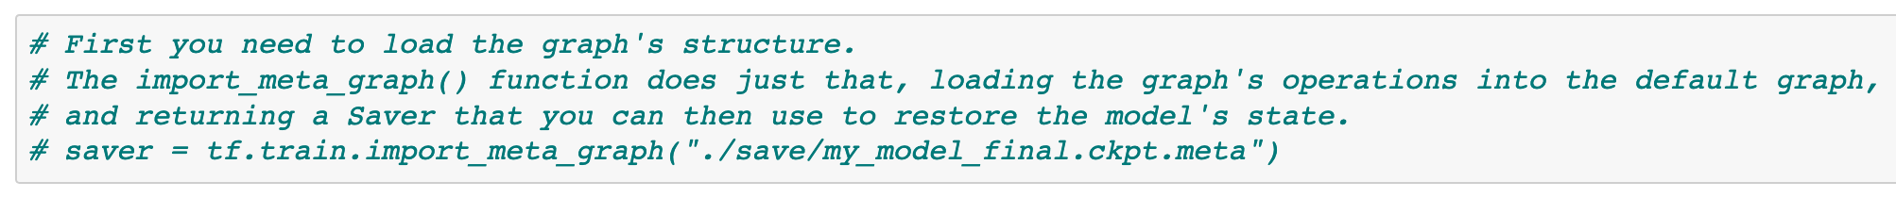
Without tf.train.import_meta_graph

Slide 20
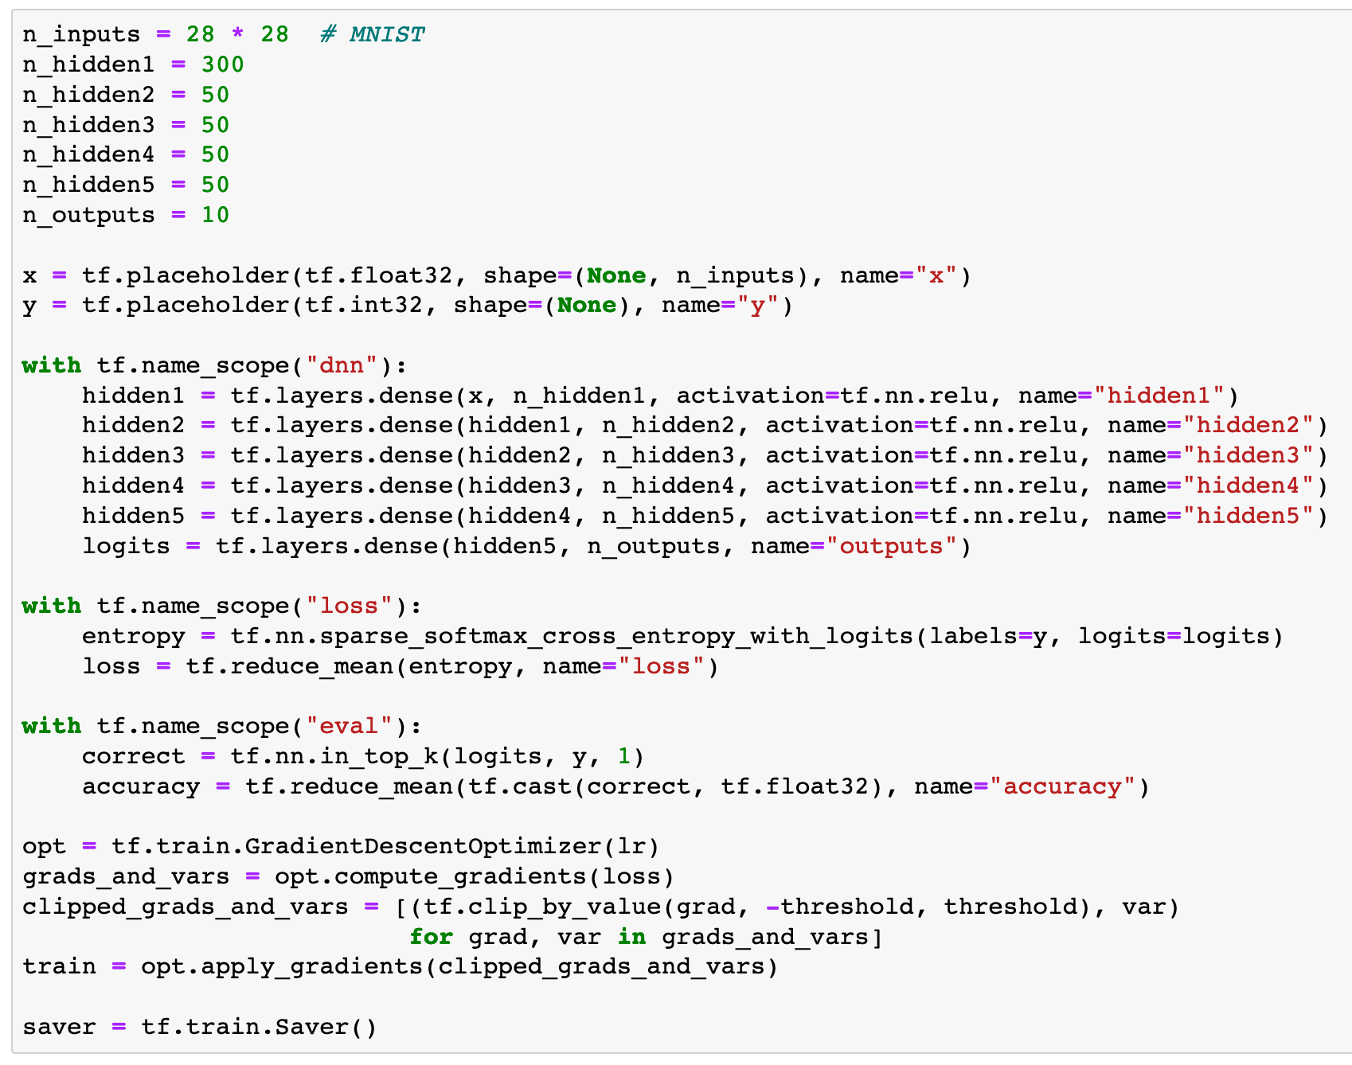

Slide 21
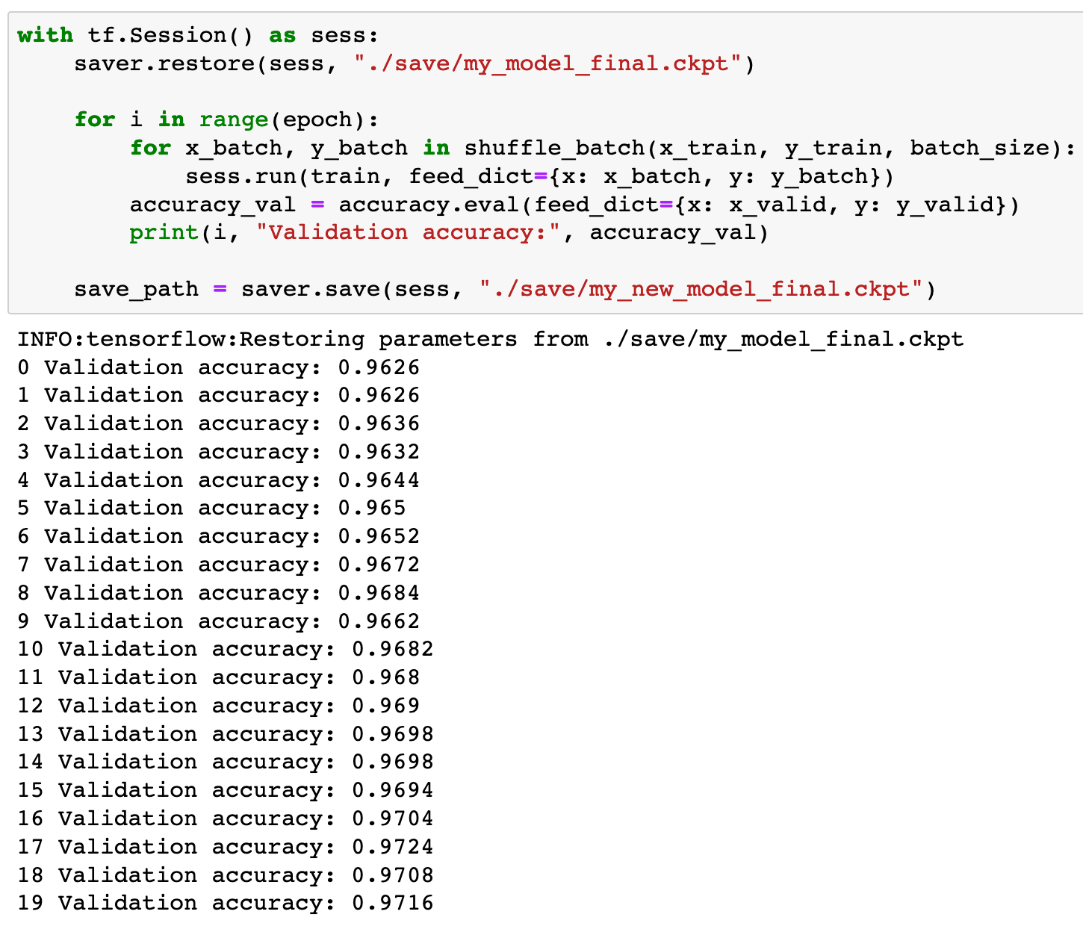

Slide 22
Now
Let’s Play with Code

